Slide 1
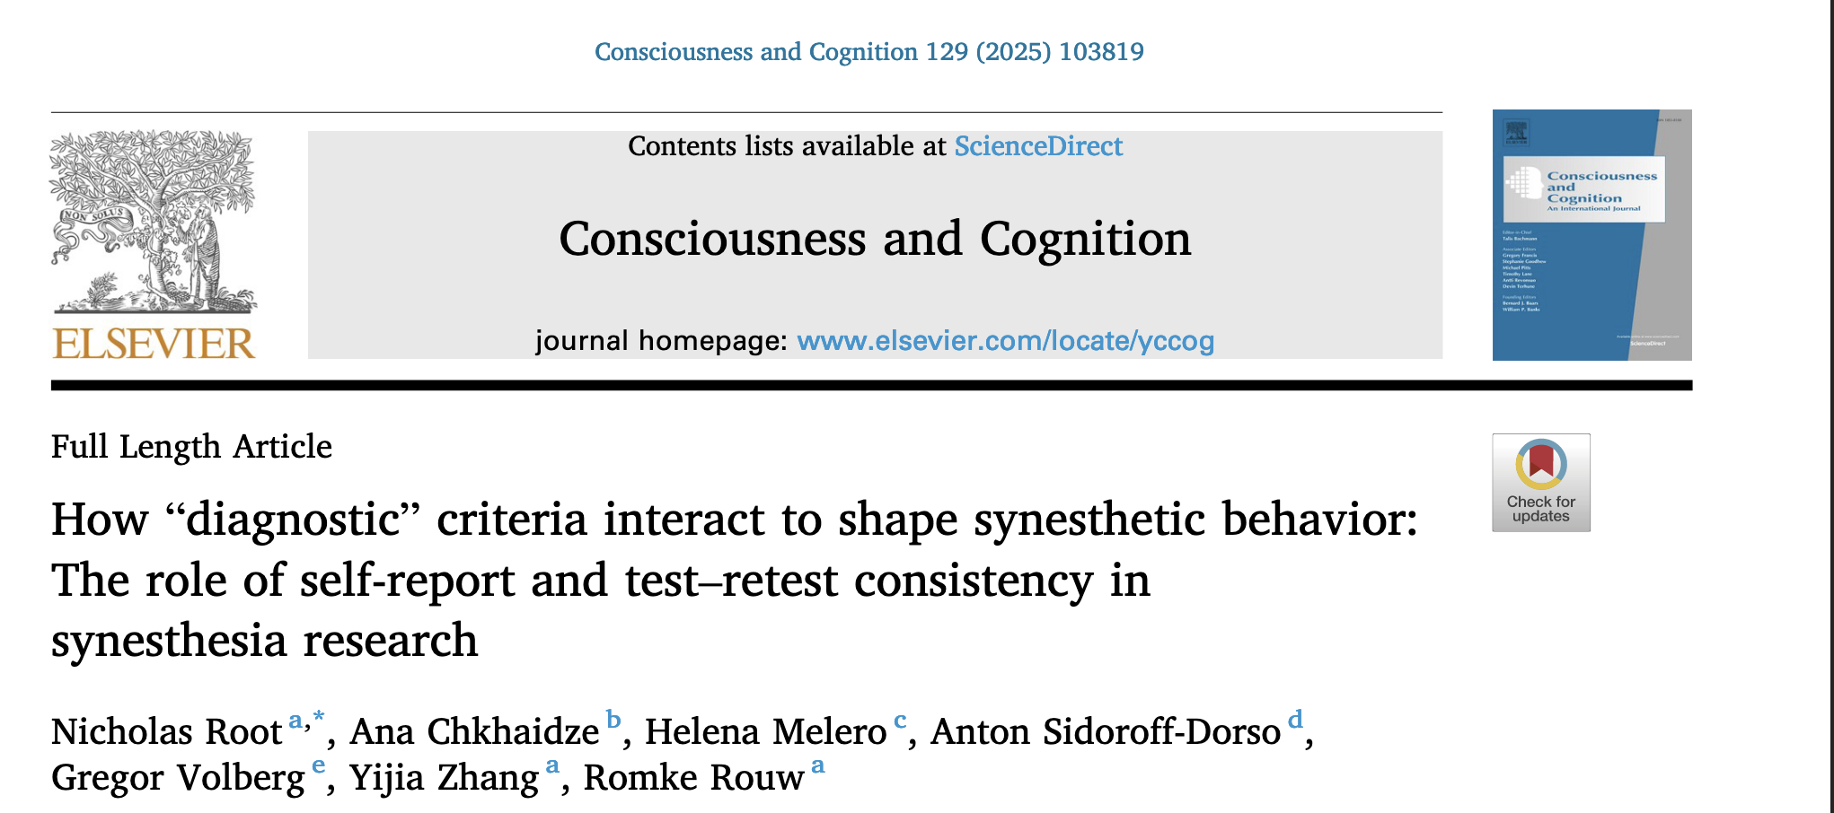
Universitäres Institut akkreditiert nach HFKG
Institut universitaire accrédité selon la LEHE
Journal Club 16/06/2025
Notes:
Recent paper
Not discuss everything. Mostly important for the question raised and idea of future directions and projects.

Slide 2
What differentiates synestetic from non synesthetic experience?
Motivations
Notes:
I am reflecting on a reliable measure to differentiate sequence space synesthesia with numbers.
This paper is pertinent since it is approcahing this question but for grapheme-colour synesthesia.

Slide 3
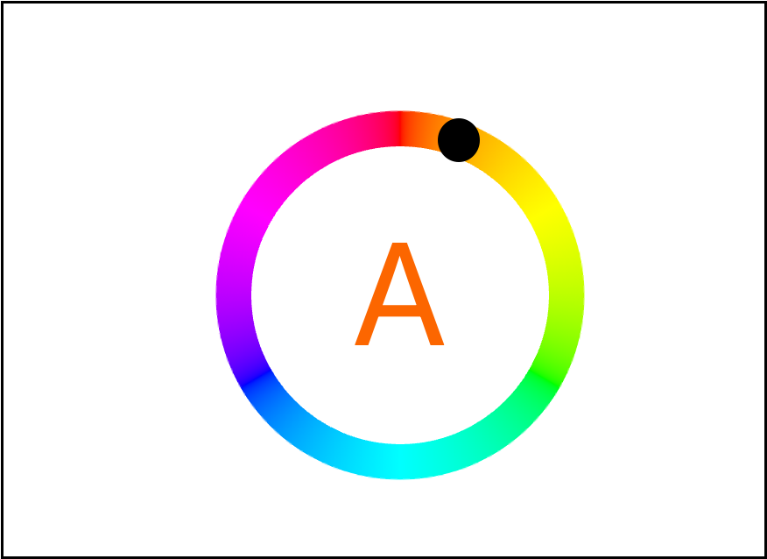
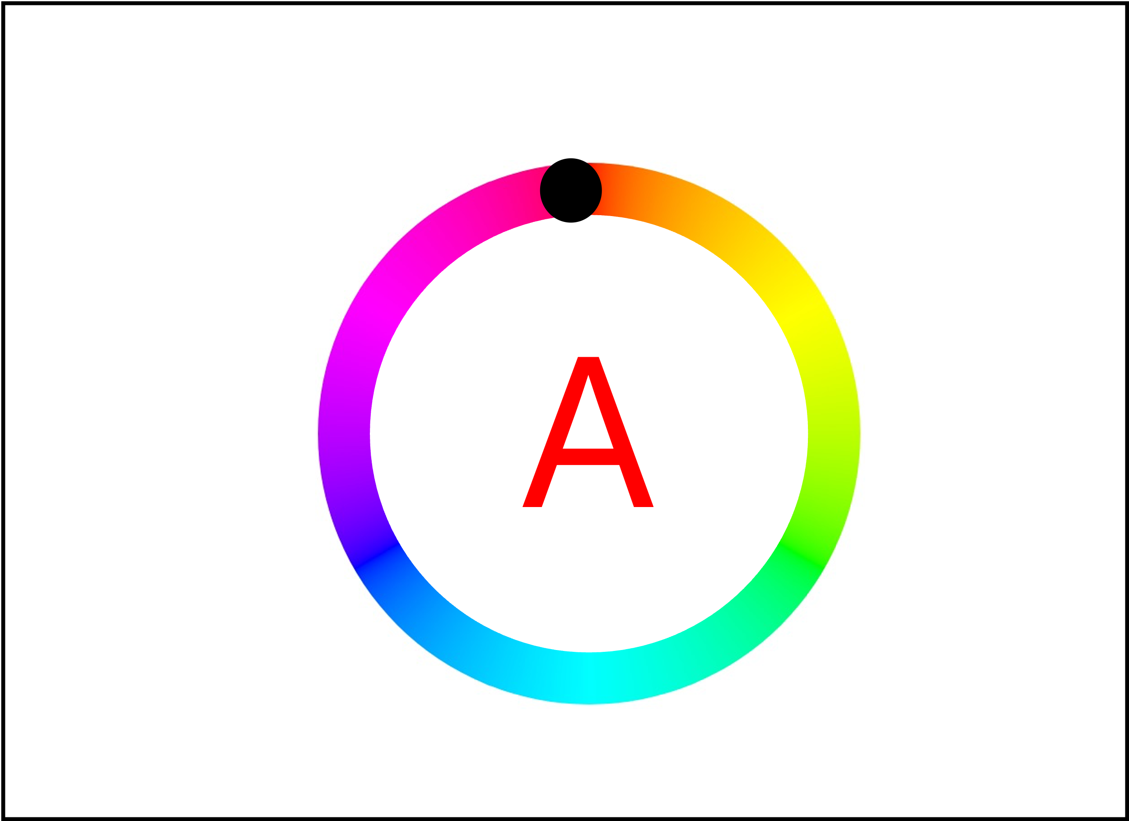
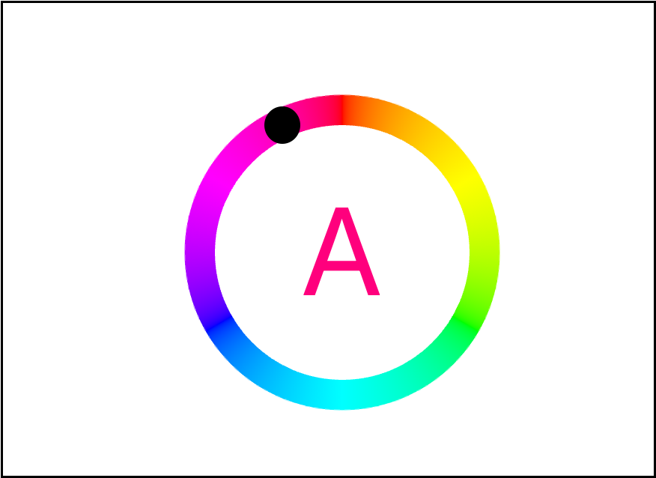
How to “diagnose” grapheme-colour synesthesia?
Grapheme-color synesthesia
5 criteria:
Unidirectionality
i.e. A → Red; Red ↛ A
Conscious
Automatic
Early in Development
Consistency
Test-retest
Trial 1
Euclidean distance between the colors determines consistency of letter A
Trial 34
Trial 185
Notes:
Similar procedure is used for grapheme-colour synesthesia, for the present paper.

Slide 4
Consistency test vs self-report
The present paper
Notes:
Compare both

Slide 5
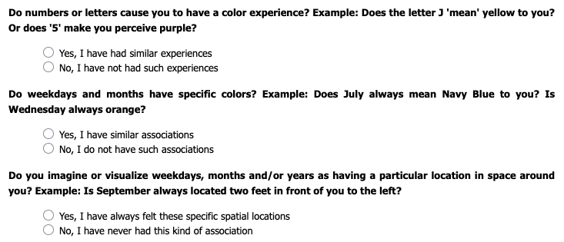
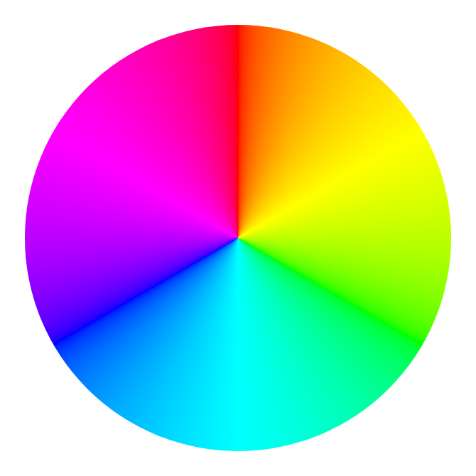
Self-report vs consistency test
Self reported questionnaire
Consistency test
“What synesthetic colour does this grapheme elciti?”
A
Notes:
Two masure might lead to 4 different possibilities:

Slide 6
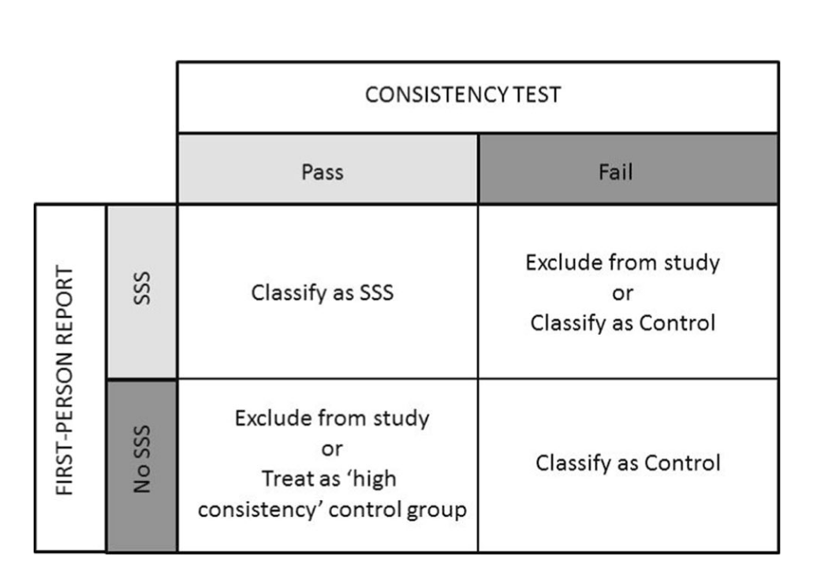

Self-report vs consistency test.
 |  | Consistency test
 |  | Pass | Fail
Self-report questionnaire | Pass | Consistent Synesthete | Inconsistent synesthetes
 | Fail | Consistent non synesthetes | Non-synesthete
Rothen et al., 2016
Root et al., 2025
Notes:
This is investigated through 4 studies in this paper

Slide 7
4 studies
Study 1
“test the generalizability of the [...] 135.3 cutoff score”
Study 2
“behavior of inconsistent self-reported synesthetes”
Study 3
“validity of self-report as the sole diagnostic criterion for synesthesia.”
Study 4
“[…] effects of the raw (continuous) consistency score, […]”
Notes:
Study 1: won’t talk about synesthesia with chinese logographic scripts because only 24 participants.
Study 2: won’t talk about the classifier trained on the data

Slide 8
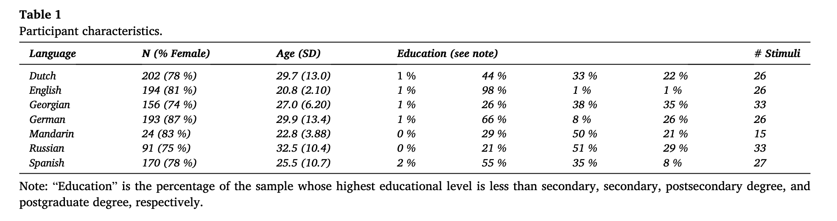
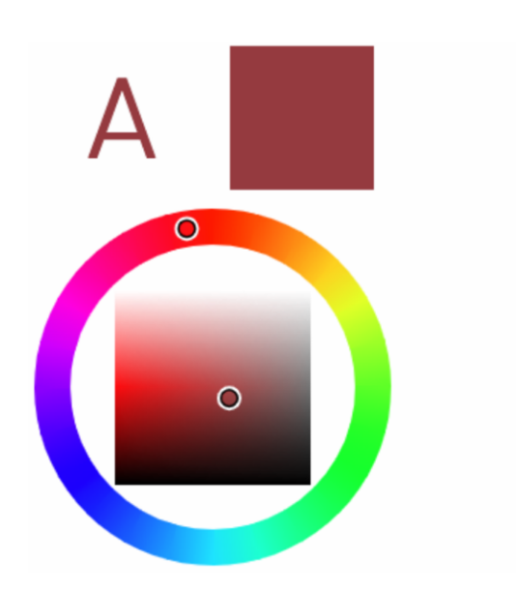
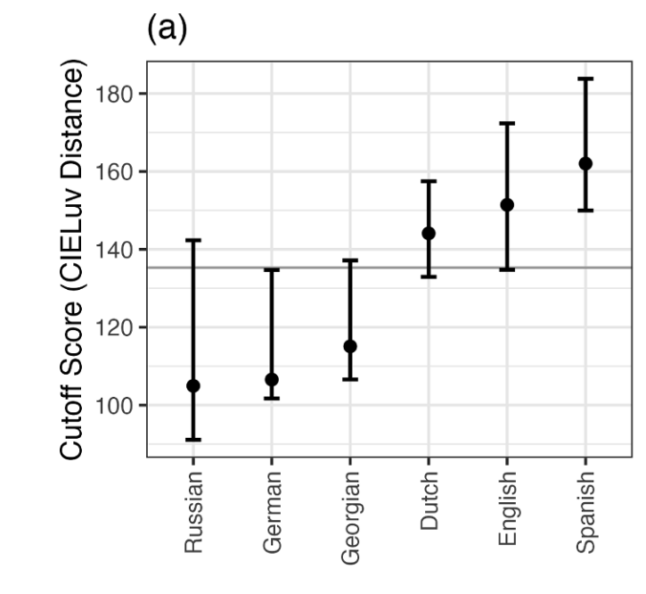
Study 1
“consistency cutoffs differ across languages”
Task:
Colour-picker:
Self Report:
“read a short paragraph describing synesthesia, and then indicate whether they think they have grapheme-color synesthesia […]”
Participants:
“146 Dutch, 104 English, 94 Georgian, 147 German, 13 Mandarin, 60 Russian, and 88 Spanish participants.”
Results: Optimal cut off scores per language:
Error bars = 95 % bootstraped confidence intervals
Notes:
Find an interaction with language
3 repetitions for each letter
Only letters (set size effect?)
Control for “interactions between consistency and age, consistency and gender, and consistency and educational attainment; “

Slide 9
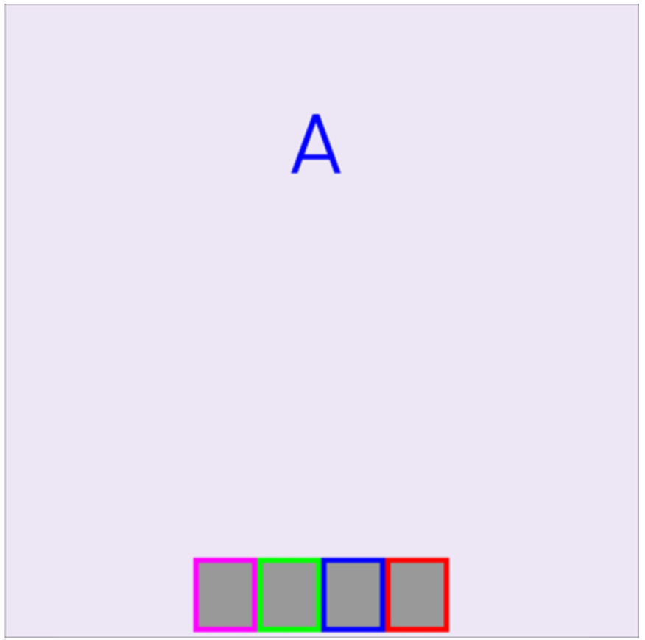
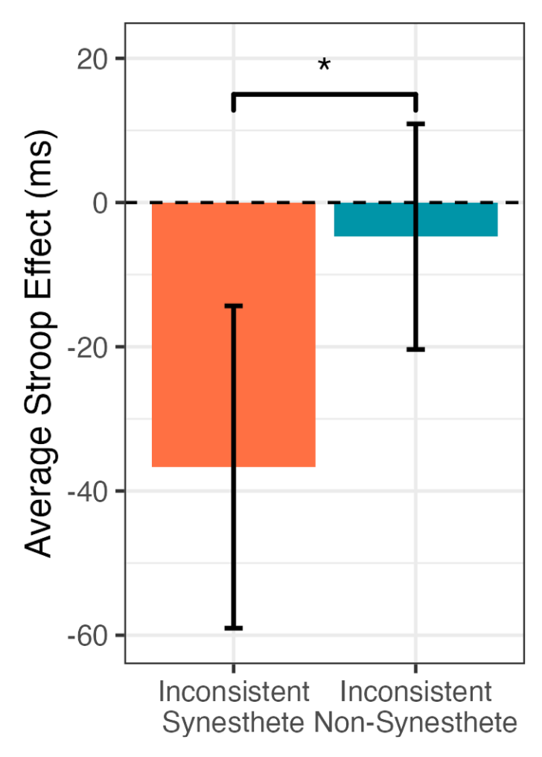
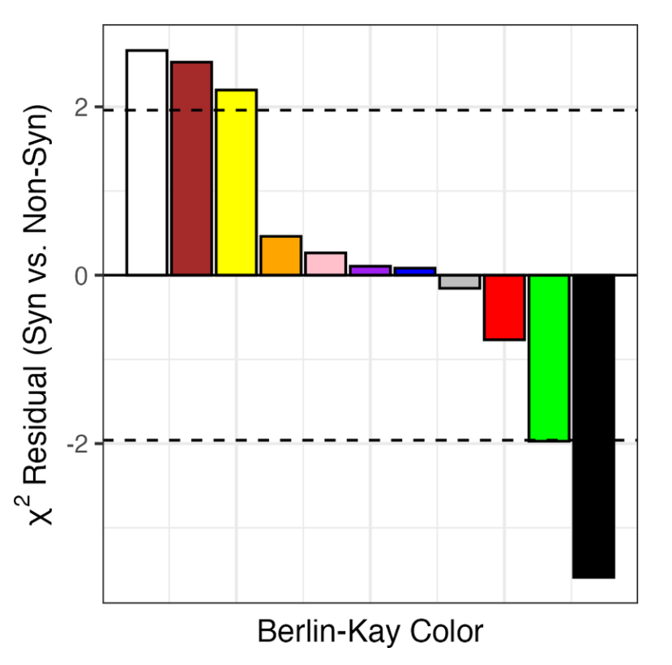
Study 2
“Inconsistent self reported synesthetes”
Tasks:
Synesthetic stroop:
-> faster when matching synesthetic colour
Synesthetic palette effect:
Synesthetes report more “warm” and “achromatic” colours than when forcing non synesthetes
Questionnaire: forced to chooose between synesthete or not (i.e. no ”maybe” possibility)
Participants: 169 dutch. How many per group?
Results:
Stroop Palette
synesthetes
Congruent – incongruent trials (ms)
non synesthetes
95 % confidence interval
135.3 cutoff score
Notes:
How many partcipants in the inconsistent synesthetes vs non synesthetes?
Stimuli: 4 most consistent letters. Might be that synesthetic only for limited set of letters? (hence overall inconsistent?)
95 % CI seem to overlap
“the four keys corresponded to the participants’ own color choices for the four letter stimuli;” (Root et al., 2025, p. 9)
“We selected four letter stimuli for each participant.” (Root et al., 2025, p. 9)
“the pair of letters whose colors were most distant in CIELuv color space, and the two most consistent letters whose colors were at least 45 CIELuv units from each other.” (Root et al., 2025, p. 9)
160 trials practice trials (40 congr, 120 incongruent). 10 repetition per letter combination.

Slide 10
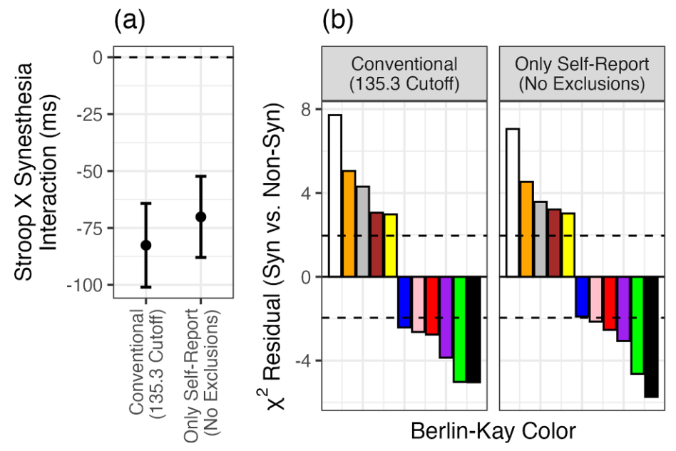
Study 3
“Self-report alone is sufficient to distinguish synesthetes from non-synesthetes”
Compare the effect size if subsampling
 |  | Consistency test
 |  | Pass | Fail
Self-report questionnaire | Pass | Synesthete 146 | Inconsistent synesthetes 23
 | Fail | Consistent non synesthetes | Non-synesthete
N = 146 N = 146+23
Notes:
Should have compare the effect size in consistent vs inconsistent. Not Consistent vs consistent + inconsistent

Slide 11
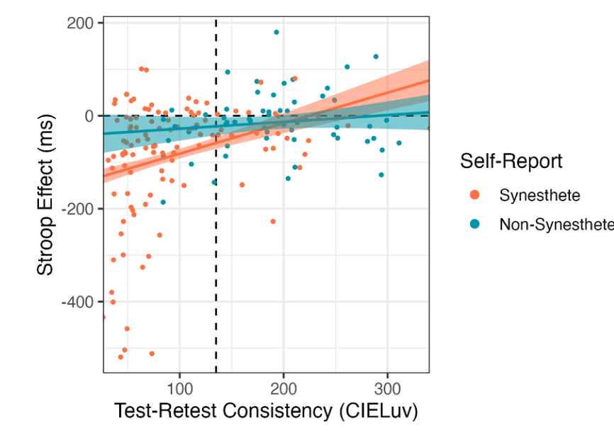
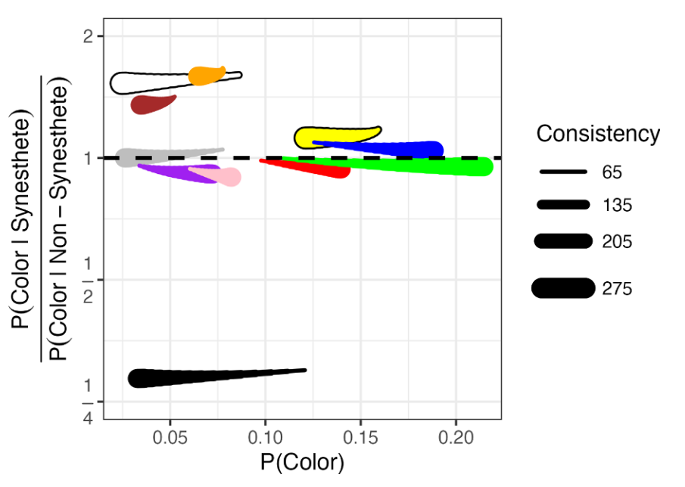
Study 4
“Self-reported synesthetes and non-synesthetes can be distinguished even after controlling for consistency”
Consistency as a consinous variable
More if conistent
More if inconsistent
More common in synesthetes
Equally
common
Synesthetic risk ratio
More common in
non-synesthetes
“the path traced from the narrower line end to the thicker line end indicates how the color prevalence changes as a participant becomes more inconsistent”
Notes:
after controlling for synesthesia, green is more common in inconsistent participants” (Root et al., 2025, p. 15)
Grey is equally common if synesthetes and non synesthetes (bcs on 1). After controlling for synesthesia, consistent participants choose grey more oft than inconsistent ones. => Grey is more common in consistent rather than synesthetic participants.
→ From the point to tail. Point = If all same consistency, tail after controlling for consistency.
“grey is more common in consistent participants.” (Root et al., 2025, p. 15)

Slide 12
Discussion

Slide 13
Circularity
Exclude inconsistent synesthetes
Synesthetes differ in
consistency
Notes:
Provocative thought. Important for future projects. For example I would like to insevtigate seuqeunce space synesthesia.

Slide 14
How to “diagnose” synesthesia?
Sequence space synesthesia
3
3
Unidirectionality
Conscious
Automatic
Development
Consistency
Trial 5
Trial 42
Trial 201
3
3
…
4
3
Euclidean distance between the colors determines consistency of the position of each sequence
Notes:
For example

Slide 15
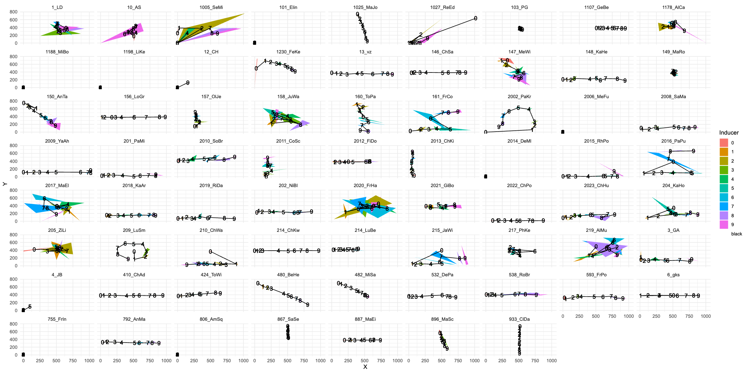
Notes:
Not only consistency but also form is difficult to diagnose

Slide 16
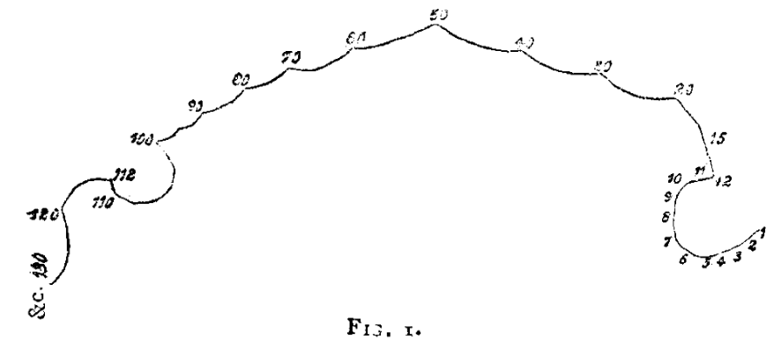
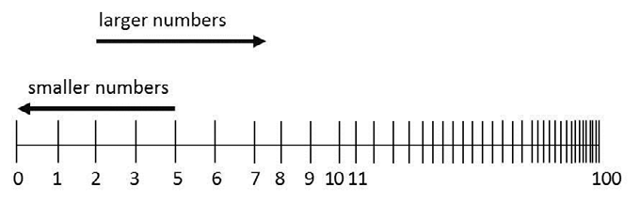
Number forms
RQ: How to differentiate synesthetes and non-synesthetes number-space representations?
Non-synesthetes:
Mental Number Line
Oriented, i.e. left: small numbers, right large numbers (depending on reading direction)
Logarithmically compressed for larger numbers
Synesthetes:
Idiosyncrathic
Jump
Curbe
Notes:
What differentiates synestetic from non synesthetic experience?

Slide 17
What differentiates synestetic from non synesthetic experience?
Notes:
I am reflecting on a reliable measure to differentiate sequence space synesthesia with numbers.
This paper is pertinent since it is approcahing this question but for grapheme-colour synesthesia.

Slide 18
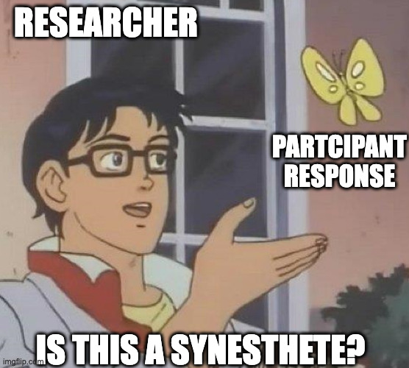
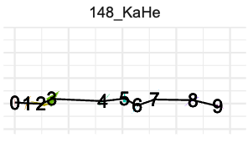
How to “diagnose” synesthesia?
Sequence space synesthesia
Mental Number Line:
Automatic
Consistency
Test-retest
Conscious
Unidirectionality
i.e. A → Red; Red ↛ A
Early in Development
Notes:
The image represent the consistency of three responses from a synesthete in Rothen et al., 2016. The task was to click in a 2D space where the person percieves a certain digit. The perimenter of each triangle is used to caclulate participant’s consithency

Slide 19
Future directions?
What is the role of language in synesthesia?
Do sequence space synesthetes number-form depend or vary according to language/script?
Reading direction
LTR or RTL
Script
Alphabet, logographic, sign language, invented symbols?

Slide 20
Vielen Dank für Ihre Aufmerksamkeit! Merci pour votre attention ! Thank you for your attention!
Universitäres Institut akkreditiert nach HFKG
Institut universitaire accrédité selon la LEHE

